Slide 1

IDPs in Gathering Sites Mapping Exercise Training
26th September 2023
Sudan Site Management Sector
Deograsias MALLYA, SMS IMO

Slide 2

Sector Overview & Objective
The reactivation of the Site Management Sector, which is led by UNHCR, was officially endorsed during the Humanitarian Country Team (HCT) meeting on July 18th, 2023.
Main Objective
Enable a multi-sectoral humanitarian response in displacement sites.
Promotion of out of camp approaches to reduce risks of protracted displacement and humanitarian dependencies (camps/site as last resort options)
Notes:
Site management is the coordination and monitoring of service provision, protection and assistance in locations where people displace to. Applying the legal protection framework and minimum humanitarian standards through community governance and participatory systems, site management is both technical and social. It aims to make sure services and protection provided in communal settings are in line with national and international laws, guidelines and agreed standards, to improve quality of life and dignity during displacement and to advocate for lasting (“durable”) solutions.
The term “site” is increasingly used in the sector to apply to camps and camp-like settings including planned camps, self-settled camps, collective centers, reception and transit centers, and evacuation centers.
Camps (of every temporary shelter category) should remain the option of last resort and a temporary solution.

Slide 3

Roles & Structure in accordance with IASC policies
Six Core Functions:
  Supporting service delivery
  Informing strategic decision-making
  Planning and strategy development
  Advocacy
  Monitoring and reporting
  Contingency planning/preparedness/ capacity building
Leadership: Chaired by UNHCR and Co-chaired preferably an I/NNGO
Membership: All humanitarian organization/entity active in the camp coordination and camp management sector or with expertise
Frequency of meetings: Every two weeks

Slide 4




Priorities of National Sector Coordination
Partners Contact Details List: Contact List Tool
Name, Organization, position, location, email and phone number
Sector’s ToR has been endorsed and circulated to all members
IDP in Gathering Site Mapping: Site Mapping Tool
Sites Unique ID (P Codes etc.) assigned through Global GIS Unit
A master list database (excel, sql etc.) of sites with Population data (Ind & HH), GPS locations clearly indicating the alternative names of sites in local language etc.
IDPs in Gathering Sites Dashboard per State

Slide 5

Priorities (Templates/ Tools) Contin……….
Site Management Partners Presence (4Ws) Mapping: Partners Presence - 4Ws Tool
The 4Ws (Who, What, When, When) is under development phase and will serve as a standardized reporting tool for all activities associated with site management

Slide 6


Way Forward (Assessments)
Household Assessments (ex. Needs Assessment)
Key Informant Interview (KII) Assessments (ex. Site Assessment)
Enrollment Survey (ex. Camp/ Site Population Database)
Etc.

Slide 7
???

Slide 8

Mobile Humanitarian Data Collection Made Easy
http://www.kobo.unhcr.org

Slide 9
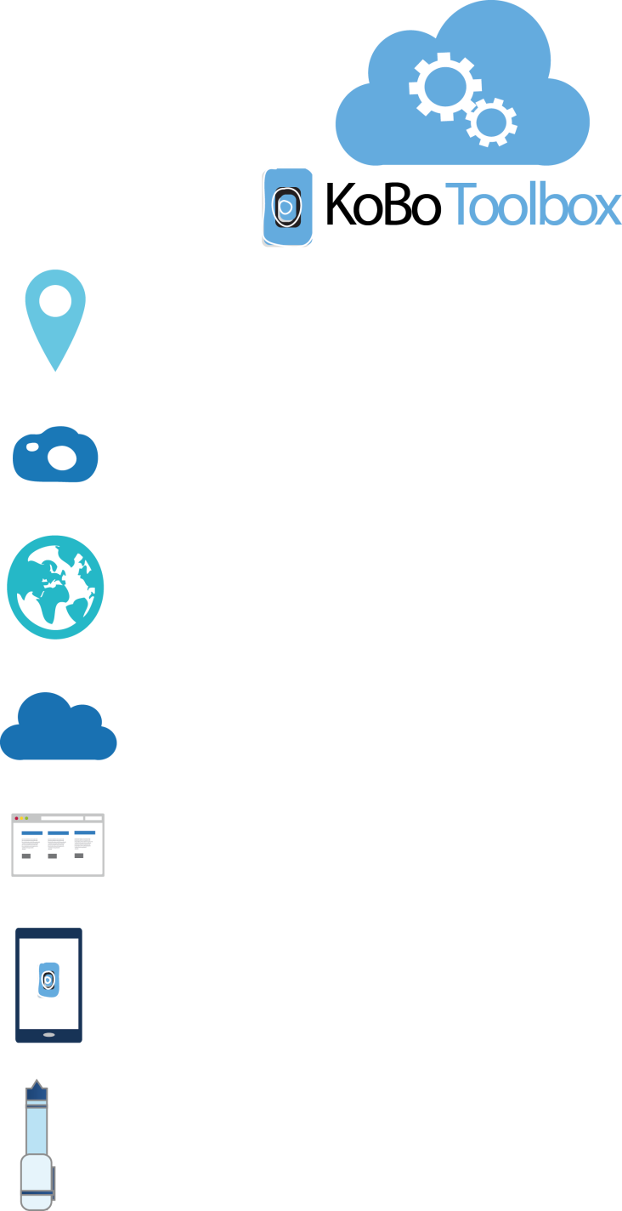
Key Advantages
Collect GPS locations
Take a photographs
Collect data offline
Sync data immediately or later
Collect data on paper form and data entry on browser
Collect on mobile devices
Design your own digital forms without programming

Slide 10
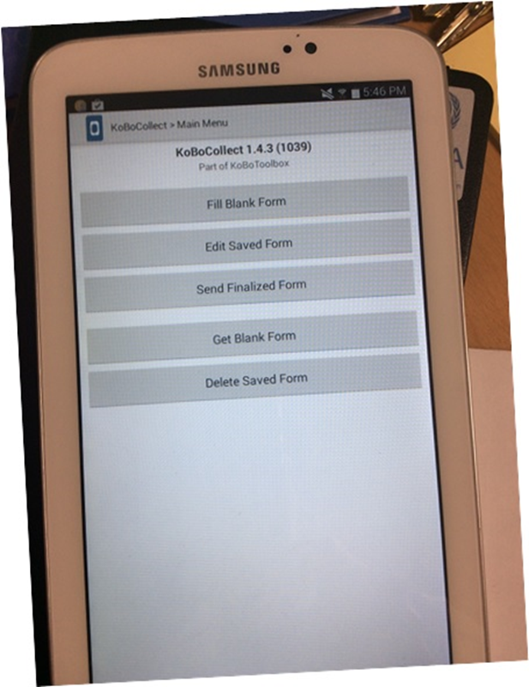
Kobo Configuration on Tablet/ Mobile Phone
Install Kobo Collect on your Android device.
Click on to open settings.
Enter the server URL https://kobocat.unhcr.org
and your username and password.
Open "Get Blank Form" and select your project.
Open "Enter Data."

Slide 11
Site Mapping Tool
The Kobo-based Site Mapping Tool has been specifically designed to prepare a master list of all sites with basic site information. The tool's functionality allows for dynamic updates, ensuring that the list remains up-to-date as new sites are identified or changes occur in the existing ones.
Sites Unique ID (P Codes etc.) assigned through Global GIS Unit
Population data (Ind & HH)
GPS locations clearly indicating the alternative names of sites in local language etc.

Slide 12

Results
Results will be published on
https://cccmcluster.org/operations/Sudan
IDPs in Gathering Sites Dashboard per State
IDPs in Gathering Sites Master List
Power BI interactive Dashboard for Sudan Operation

Slide 13
???

